Slide 1
ECON1002 Intro. Macro.
Tutorial 6
Herbert Xin
wei.xin@sydney.edu.au

Slide 2
Plan of Today
Concept Review
1.1 Balanced budget multiplier
1.2 Automatic stabiliser
2. Tutorial Questions
3. Assessments
3.1 Don’t forget about your Quiz 1! (Open until Apr 8)
3.2 Midsemester Exam (Apr 11 at 18:00 Online)
3.2.1 Covers Week 1 to 5 (Fiscal Policy)

Slide 3
Balanced budget multiplier

Slide 4
Balanced budget multiplier
A combination of changes in government’s tax operations, that keep government budget balanced, but have an impact on the output.

Slide 5
Balanced budget multiplier
A combination of changes in government’s tax operations, that keep government budget balanced, but have an impact on the output.
Cash Bonus Example

Slide 6

Balanced budget multiplier
A combination of changes in government’s tax operations, that keep government budget balanced, but have an impact on the output.
Cash Bonus Example
$$PAE=C+I^{P}+G+NX$$

Slide 7
Balanced budget multiplier
A combination of changes in government’s tax operations, that keep government budget balanced, but have an impact on the output.
Cash Bonus Example
$$PAE=C+I^{P}+G+NX$$
$$PAE=\overline{C}−c\left(Y−T\right)+I^{P}+G+NX$$

Slide 8
Balanced budget multiplier
A combination of changes in government’s tax operations, that keep government budget balanced, but have an impact on the output.
Cash Bonus Example
$$PAE=C+I^{P}+G+NX$$
$$PAE=\overline{C}−c\left(Y−T\right)+I^{P}+G+NX$$
$$PAE=\overline{C}−c[Y−(\overline{T}+τY)]+I^{P}+G+NX$$

Slide 9
Balanced budget multiplier
A combination of changes in government’s tax operations, that keep government budget balanced, but have an impact on the output.
Cash Bonus Example
$$PAE=C+I^{P}+G+NX$$
$$PAE=\overline{C}−c\left(Y−T\right)+I^{P}+G+NX$$
$$PAE=\overline{C}−c[Y−(\overline{T}+τY)]+I^{P}+G+NX$$
$$PAE=\overline{C}−cY+c\overline{T}−cτY +I^{P}+G+NX$$

Slide 10
Balanced budget multiplier
A combination of changes in government’s tax operations, that keep government budget balanced, but have an impact on the output.
Cash Bonus Example
$$PAE=C+I^{P}+G+NX$$
$$PAE=\overline{C}−c\left(Y−T\right)+I^{P}+G+NX$$
$$PAE=\overline{C}−c[Y−(\overline{T}+τY)]+I^{P}+G+NX$$
$$PAE=\overline{C}−cY+c\overline{T}−cτY +I^{P}+G+NX$$
$$PAE=\overline{C}+c\overline{T}+c(1−τ)Y +I^{P}+G+NX$$

Slide 11

Balanced budget multiplier
A combination of changes in government’s tax operations, that keep government budget balanced, but have an impact on the output.
Cash Bonus Example
Take $c=0.85$
$$PAE=C+I^{P}+G+NX$$
$$PAE=\overline{C}−c\left(Y−T\right)+I^{P}+G+NX$$
$$PAE=\overline{C}−c[Y−(\overline{T}+τY)]+I^{P}+G+NX$$
$$PAE=\overline{C}−cY+c\overline{T}−cτY +I^{P}+G+NX$$
$$PAE=\overline{C}+c\overline{T}+c(1−τ)Y +I^{P}+G+NX$$

Slide 12
Balanced budget multiplier
A combination of changes in government’s tax operations, that keep government budget balanced, but have an impact on the output.
Cash Bonus Example
Take $c=0.85$
$$PAE=C+I^{P}+G+NX$$
$$PAE=\overline{C}−0.85\overline{T}+0.85(1−τ)Y +I^{P}+G+NX$$
$$PAE=\overline{C}−c\left(Y−T\right)+I^{P}+G+NX$$
$$PAE=\overline{C}−c[Y−(\overline{T}+τY)]+I^{P}+G+NX$$
$$PAE=\overline{C}−cY+c\overline{T}−cτY +I^{P}+G+NX$$
$$PAE=\overline{C}+c\overline{T}+c(1−τ)Y +I^{P}+G+NX$$

Slide 13

Balanced budget multiplier
A combination of changes in government’s tax operations, that keep government budget balanced, but have an impact on the output.
Cash Bonus Example
Take $c=0.85$
$$PAE=C+I^{P}+G+NX$$
$$PAE=\overline{C}−0.85\overline{T}+0.85(1−τ)Y +I^{P}+G+NX$$
$$PAE=\overline{C}−c\left(Y−T\right)+I^{P}+G+NX$$
Now government gives a cash bonus of 50 units to taxpayers, i.e. $\overline{T}↓50$
$$PAE=\overline{C}−c[Y−(\overline{T}+τY)]+I^{P}+G+NX$$
$$PAE=\overline{C}−cY+c\overline{T}−cτY +I^{P}+G+NX$$
$$PAE=\overline{C}+c\overline{T}+c(1−τ)Y +I^{P}+G+NX$$

Slide 14

Balanced budget multiplier
A combination of changes in government’s tax operations, that keep government budget balanced, but have an impact on the output.
Cash Bonus Example
Take $c=0.85$
$$PAE=C+I^{P}+G+NX$$
$$PAE=\overline{C}−0.85\overline{T}+0.85(1−τ)Y +I^{P}+G+NX$$
$$PAE=\overline{C}−c\left(Y−T\right)+I^{P}+G+NX$$
Now government gives a cash bonus of 50 units to taxpayers, i.e. $\overline{T}↓50$
$$PAE=\overline{C}−c[Y−(\overline{T}+τY)]+I^{P}+G+NX$$
$$PAE=\overline{C}−cY+c\overline{T}−cτY +I^{P}+G+NX$$
$$PAE↑42.5=(0.85∗50)$$
$$PAE=\overline{C}+c\overline{T}+c(1−τ)Y +I^{P}+G+NX$$

Slide 15

Balanced budget multiplier
A combination of changes in government’s tax operations, that keep government budget balanced, but have an impact on the output.
Cash Bonus Example
Take $c=0.85$
$$PAE=C+I^{P}+G+NX$$
$$PAE=\overline{C}−0.85\overline{T}+0.85(1−τ)Y +I^{P}+G+NX$$
$$PAE=\overline{C}−c\left(Y−T\right)+I^{P}+G+NX$$
Now government gives a cash bonus of 50 units to taxpayers, i.e. $\overline{T}↓50$
$$PAE=\overline{C}−c[Y−(\overline{T}+τY)]+I^{P}+G+NX$$
$$PAE=\overline{C}−cY+c\overline{T}−cτY +I^{P}+G+NX$$
$$PAE↑42.5=(0.85∗50)$$
$$PAE=\overline{C}+c\overline{T}+c(1−τ)Y +I^{P}+G+NX$$
If this cash bonus is financed by decrease in government expenditure, i.e. $G↓50$

Slide 16

Balanced budget multiplier
A combination of changes in government’s tax operations, that keep government budget balanced, but have an impact on the output.
Cash Bonus Example
Take $c=0.85$
$$PAE=C+I^{P}+G+NX$$
$$PAE=\overline{C}−0.85\overline{T}+0.85(1−τ)Y +I^{P}+G+NX$$
$$PAE=\overline{C}−c\left(Y−T\right)+I^{P}+G+NX$$
Now government gives a cash bonus of 50 units to taxpayers, i.e. $\overline{T}↓50$
$$PAE=\overline{C}−c[Y−(\overline{T}+τY)]+I^{P}+G+NX$$
$$PAE=\overline{C}−cY+c\overline{T}−cτY +I^{P}+G+NX$$
$$PAE↑42.5=(0.85∗50)$$
$$PAE=\overline{C}+c\overline{T}+c(1−τ)Y +I^{P}+G+NX$$
If this cash bonus is financed by decrease in government expenditure, i.e. $G↓50$
$$PAE↓50$$

Slide 17

Balanced budget multiplier
A combination of changes in government’s tax operations, that keep government budget balanced, but have an impact on the output.
Cash Bonus Example
Take $c=0.85$
$$PAE=C+I^{P}+G+NX$$
$$PAE=\overline{C}−0.85\overline{T}+0.85(1−τ)Y +I^{P}+G+NX$$
$$PAE=\overline{C}−c\left(Y−T\right)+I^{P}+G+NX$$
Now government gives a cash bonus of 50 units to taxpayers, i.e. $\overline{T}↓50$
$$PAE=\overline{C}−c[Y−(\overline{T}+τY)]+I^{P}+G+NX$$
$$PAE=\overline{C}−cY+c\overline{T}−cτY +I^{P}+G+NX$$
$$PAE↑42.5=(0.85∗50)$$
$$PAE=\overline{C}+c\overline{T}+c(1−τ)Y +I^{P}+G+NX$$
If this cash bonus is financed by decrease in government expenditure, i.e. $G↓50$
$$PAE↓50$$
In total, $PAE=Y↓7.5$, but government’s budget remains balanced

Slide 18
Automatic Stabilizer
An automatic stabilizer is a policy mechanism that automatically adjusts government spending or taxation to counteract changes in the business cycle, helping to stabilize the economy without the need for discretionary policy action.

Slide 19
Automatic Stabilizer
An automatic stabilizer is a policy mechanism that automatically adjusts government spending or taxation to counteract changes in the business cycle, helping to stabilize the economy without the need for discretionary policy action.
We will see this in action in Question 3

Slide 20
Tutorial Questions

Slide 21
Question 1
Discuss the reasons why the use of fiscal policy to stabilise the economy is more complicated than suggested by the basic Keynesian model.

Slide 22
Question 1
Discuss the reasons why the use of fiscal policy to stabilise the economy is more complicated than suggested by the basic Keynesian model.

Slide 23
Question 1
Discuss the reasons why the use of fiscal policy to stabilise the economy is more complicated than suggested by the basic Keynesian model.
1. Deficit matters

Slide 24

Question 1
Discuss the reasons why the use of fiscal policy to stabilise the economy is more complicated than suggested by the basic Keynesian model.
1. Deficit matters
Deficit when $T−G<0$

Slide 25
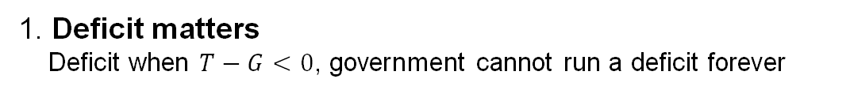
Question 1
Discuss the reasons why the use of fiscal policy to stabilise the economy is more complicated than suggested by the basic Keynesian model.
1. Deficit matters
Deficit when $T−G<0$, government cannot run a deficit forever

Slide 26
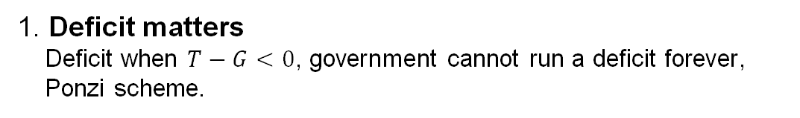
Question 1
Discuss the reasons why the use of fiscal policy to stabilise the economy is more complicated than suggested by the basic Keynesian model.
1. Deficit matters
Deficit when $T−G<0$, government cannot run a deficit forever,
Ponzi scheme.

Slide 27
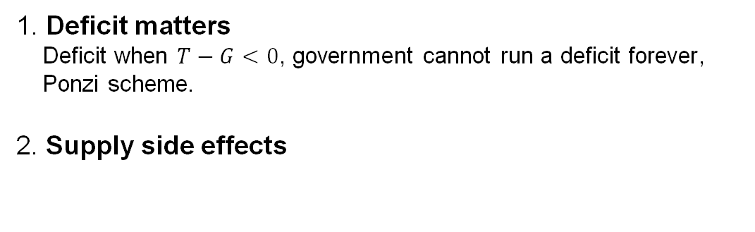
Question 1
Discuss the reasons why the use of fiscal policy to stabilise the economy is more complicated than suggested by the basic Keynesian model.
1. Deficit matters
Deficit when $T−G<0$, government cannot run a deficit forever,
Ponzi scheme.
2. Supply side effects

Slide 28
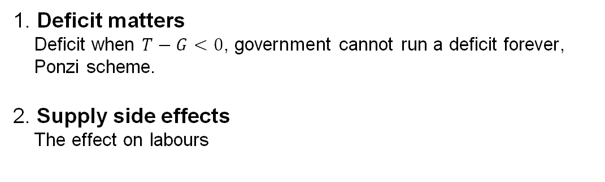
Question 1
Discuss the reasons why the use of fiscal policy to stabilise the economy is more complicated than suggested by the basic Keynesian model.
1. Deficit matters
Deficit when $T−G<0$, government cannot run a deficit forever,
Ponzi scheme.
2. Supply side effects
The effect on labours

Slide 29
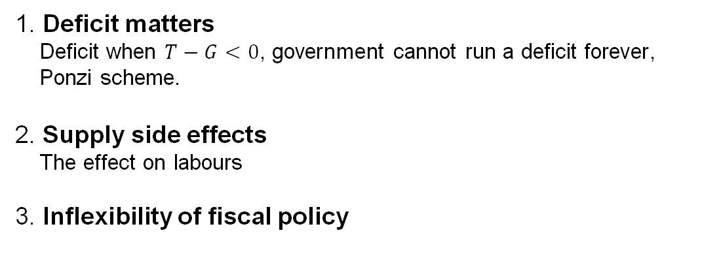
Question 1
Discuss the reasons why the use of fiscal policy to stabilise the economy is more complicated than suggested by the basic Keynesian model.
1. Deficit matters
Deficit when $T−G<0$, government cannot run a deficit forever,
Ponzi scheme.
2. Supply side effects
The effect on labours
3. Inflexibility of fiscal policy

Slide 30
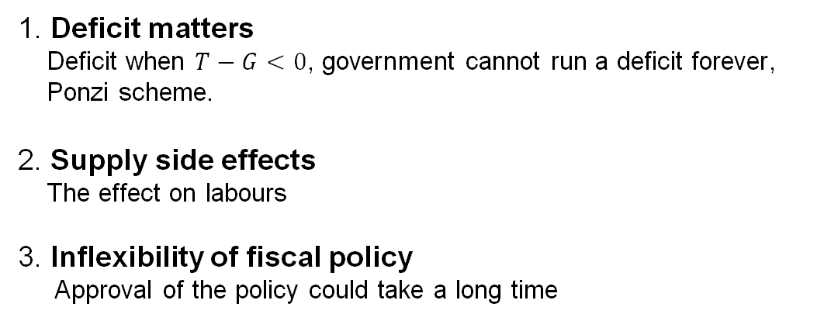
Question 1
Discuss the reasons why the use of fiscal policy to stabilise the economy is more complicated than suggested by the basic Keynesian model.
1. Deficit matters
Deficit when $T−G<0$, government cannot run a deficit forever,
Ponzi scheme.
2. Supply side effects
The effect on labours
3. Inflexibility of fiscal policy
Approval of the policy could take a long time

Slide 31
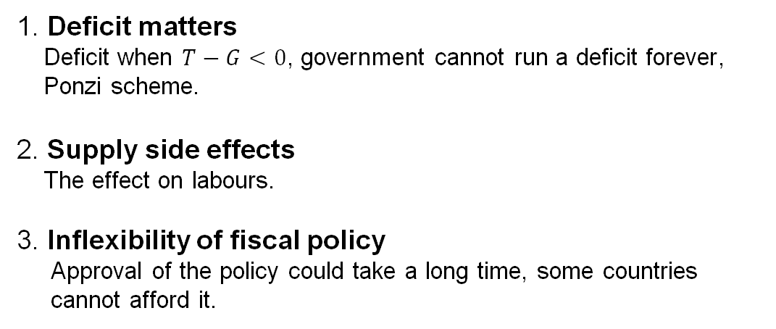
Question 1
Discuss the reasons why the use of fiscal policy to stabilise the economy is more complicated than suggested by the basic Keynesian model.
1. Deficit matters
Deficit when $T−G<0$, government cannot run a deficit forever,
Ponzi scheme.
2. Supply side effects
The effect on labours.
3. Inflexibility of fiscal policy
Approval of the policy could take a long time, some countries
cannot afford it.

Slide 32






Question 2
An economy is described by the following equations. The multiplier is 5.
$$C=40+0.8(Y−T)$$
$$I^{P}=70$$
$$G=120$$
$$NX=10$$
$$T=150$$
$$Y^{∗}=580$$

Slide 33
Question 2
An economy is described by the following equations. The multiplier is 5.
a. Find the numerical equation relating planned aggregate expenditure to output.
$$C=40+0.8(Y−T)$$
$$I^{P}=70$$
$$G=120$$
$$NX=10$$
$$T=150$$
$$Y^{∗}=580$$

Slide 34

Question 2
An economy is described by the following equations. The multiplier is 5.
a. Find the numerical equation relating planned aggregate expenditure to output.
$$C=40+0.8(Y−T)$$
$$PAE=C+I^{P}+G+NX$$
$$I^{P}=70$$
$$PAE=40+0.8\left(Y−150\right)+70+120+10$$
$$G=120$$
$$NX=10$$
$$T=150$$
$$Y^{∗}=580$$

Slide 35

Question 2
An economy is described by the following equations. The multiplier is 5.
a. Find the numerical equation relating planned aggregate expenditure to output.
$$C=40+0.8(Y−T)$$
$$PAE=C+I^{P}+G+NX$$
$$I^{P}=70$$
$$PAE=40+0.8\left(Y−150\right)+70+120+10$$
$$PAE=0.8Y+120$$
$$G=120$$
$$NX=10$$
$$T=150$$
$$Y^{∗}=580$$

Slide 36

Question 2
An economy is described by the following equations. The multiplier is 5.
a. Find the numerical equation relating planned aggregate expenditure to output.
$$C=40+0.8(Y−T)$$
$$PAE=C+I^{P}+G+NX$$
$$I^{P}=70$$
$$PAE=40+0.8\left(Y−150\right)+70+120+10$$
$$PAE=0.8Y+120$$
$$G=120$$
$$NX=10$$
$$T=150$$
$$Y^{∗}=580$$

Slide 37

Question 2
An economy is described by the following equations. The multiplier is 5.
a. Find the numerical equation relating planned aggregate expenditure to output.
$$C=40+0.8(Y−T)$$
$$PAE=C+I^{P}+G+NX$$
$$I^{P}=70$$
$$PAE=40+0.8\left(Y−150\right)+70+120+10$$
$$PAE=0.8Y+120$$
$$G=120$$
Short-run equilibrium condition
$$NX=10$$
$$Y=PAE$$
$$T=150$$
$$Y^{∗}=580$$

Slide 38

Question 2
An economy is described by the following equations. The multiplier is 5.
a. Find the numerical equation relating planned aggregate expenditure to output.
$$C=40+0.8(Y−T)$$
$$PAE=C+I^{P}+G+NX$$
$$I^{P}=70$$
$$PAE=40+0.8\left(Y−150\right)+70+120+10$$
$$PAE=0.8Y+120$$
$$G=120$$
Short-run equilibrium condition
$$NX=10$$
$$Y=PAE=0.8Y+120$$
$$T=150$$
$$Y^{∗}=580$$

Slide 39

Question 2
An economy is described by the following equations. The multiplier is 5.
a. Find the numerical equation relating planned aggregate expenditure to output.
$$C=40+0.8(Y−T)$$
$$PAE=C+I^{P}+G+NX$$
$$I^{P}=70$$
$$PAE=40+0.8\left(Y−150\right)+70+120+10$$
$$PAE=0.8Y+120$$
$$G=120$$
Short-run equilibrium condition
$$NX=10$$
$$Y=PAE=0.8Y+120$$
$$T=150$$
$$0.2Y=120$$
$$Y^{∗}=580$$

Slide 40
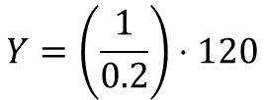
Question 2
An economy is described by the following equations. The multiplier is 5.
a. Find the numerical equation relating planned aggregate expenditure to output.
$$C=40+0.8(Y−T)$$
$$PAE=C+I^{P}+G+NX$$
$$I^{P}=70$$
$$PAE=40+0.8\left(Y−150\right)+70+120+10$$
$$PAE=0.8Y+120$$
$$G=120$$
Short-run equilibrium condition
$$NX=10$$
$$Y=PAE=0.8Y+120$$
$$T=150$$
$$0.2Y=120$$
$$Y=\left(\frac{1}{0.2}\right)⋅120$$
$$Y^{∗}=580$$

Slide 41
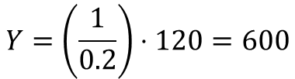
Question 2
An economy is described by the following equations. The multiplier is 5.
a. Find the numerical equation relating planned aggregate expenditure to output.
$$C=40+0.8(Y−T)$$
$$PAE=C+I^{P}+G+NX$$
$$I^{P}=70$$
$$PAE=40+0.8\left(Y−150\right)+70+120+10$$
$$PAE=0.8Y+120$$
$$G=120$$
Short-run equilibrium condition
$$NX=10$$
$$Y=PAE=0.8Y+120$$
$$T=150$$
$$0.2Y=120$$
$$Y=\left(\frac{1}{0.2}\right)⋅120=600$$
$$Y^{∗}=580$$

Slide 42
Question 2
An economy is described by the following equations. The multiplier is 5.
a. Find the numerical equation relating planned aggregate expenditure to output.
$$C=40+0.8(Y−T)$$
$$PAE=C+I^{P}+G+NX$$
$$I^{P}=70$$
$$PAE=40+0.8\left(Y−150\right)+70+120+10$$
$$PAE=0.8Y+120$$
$$G=120$$
Short-run equilibrium condition
$$NX=10$$
$$Y=PAE=0.8Y+120$$
$$T=150$$
Multiplier = 5
$$0.2Y=120$$
$$Y=\left(\frac{1}{0.2}\right)⋅120=600$$
$$Y^{∗}=580$$

Slide 43
Question 2
An economy is described by the following equations. The multiplier is 5.
b. By how much would government purchases have to change in order to eliminate any output gap?
$$C=40+0.8(Y−T)$$
$$I^{P}=70$$
$$G=120$$
$$NX=10$$
$$T=150$$
$$Y^{∗}=580$$

Slide 44
Question 2
An economy is described by the following equations. The multiplier is 5.
b. By how much would government purchases have to change in order to eliminate any output gap?
$$C=40+0.8(Y−T)$$
$$I^{P}=70$$
$$G=120$$
$$NX=10$$
$$T=150$$
$$Y^{∗}=580$$

Slide 45

Question 2
An economy is described by the following equations. The multiplier is 5.
b. By how much would government purchases have to change in order to eliminate any output gap?
$$C=40+0.8(Y−T)$$
Output Gap
$$X=Y−Y^{∗}$$
$$I^{P}=70$$
$$G=120$$
$$NX=10$$
$$T=150$$
$$Y^{∗}=580$$

Slide 46

Question 2
An economy is described by the following equations. The multiplier is 5.
b. By how much would government purchases have to change in order to eliminate any output gap?
$$C=40+0.8(Y−T)$$
Output Gap
$$X=Y−Y^{∗}$$
$$I^{P}=70$$
$$X=0 →Y^{∗}=Y$$
$$G=120$$
$$NX=10$$
$$T=150$$
$$Y^{∗}=580$$

Slide 47

Question 2
An economy is described by the following equations. The multiplier is 5.
b. By how much would government purchases have to change in order to eliminate any output gap?
$$C=40+0.8(Y−T)$$
Output Gap
$$X=Y−Y^{∗}$$
$$I^{P}=70$$
$$X=0 →Y^{∗}=Y$$
$$G=120$$
$$Y^{∗}=C+I^{P}+G^{∗}+NX$$
$$NX=10$$
$$T=150$$
$$Y^{∗}=580$$

Slide 48
Question 2
An economy is described by the following equations. The multiplier is 5.
b. By how much would government purchases have to change in order to eliminate any output gap?
$$C=40+0.8(Y−T)$$
Output Gap
$$X=Y−Y^{∗}$$
$$I^{P}=70$$
$$X=0 →Y^{∗}=Y$$
$$G=120$$
$$Y^{∗}=C+I^{P}+G^{∗}+NX$$
$$NX=10$$
$$Y^{∗}=40+0.8\left(Y^{∗}−150\right)+70+G^{∗}+10$$
$$T=150$$
$$Y^{∗}=580$$

Slide 49
Question 2
An economy is described by the following equations. The multiplier is 5.
b. By how much would government purchases have to change in order to eliminate any output gap?
$$C=40+0.8(Y−T)$$
Output Gap
$$X=Y−Y^{∗}$$
$$I^{P}=70$$
$$X=0 →Y^{∗}=Y$$
$$G=120$$
$$Y^{∗}=C+I^{P}+G^{∗}+NX$$
$$NX=10$$
$$Y^{∗}=40+0.8\left(Y^{∗}−150\right)+70+G^{∗}+10$$
$$580=40+0.8\left(580−150\right)+70+G^{∗}+10$$
$$T=150$$
$$Y^{∗}=580$$

Slide 50

Question 2
An economy is described by the following equations. The multiplier is 5.
b. By how much would government purchases have to change in order to eliminate any output gap?
$$C=40+0.8(Y−T)$$
Output Gap
$$X=Y−Y^{∗}$$
$$I^{P}=70$$
$$X=0 →Y^{∗}=Y$$
$$G=120$$
$$Y^{∗}=C+I^{P}+G^{∗}+NX$$
$$NX=10$$
$$Y^{∗}=40+0.8\left(Y^{∗}−150\right)+70+G^{∗}+10$$
$$580=40+0.8\left(580−150\right)+70+G^{∗}+10$$
$$T=150$$
$$G=116$$
$$Y^{∗}=580$$

Slide 51


Question 2
An economy is described by the following equations. The multiplier is 5.
b. By how much would government purchases have to change in order to eliminate any output gap?
$$C=40+0.8(Y−T)$$
Output Gap
$$X=Y−Y^{∗}$$
$$I^{P}=70$$
$$X=0 →Y^{∗}=Y$$
$$G=120$$
$$Y^{∗}=C+I^{P}+G^{∗}+NX$$
$$NX=10$$
$$Y^{∗}=40+0.8\left(Y^{∗}−150\right)+70+G^{∗}+10$$
$$580=40+0.8\left(580−150\right)+70+G^{∗}+10$$
$$T=150$$
$$G=116$$
$$Y^{∗}=580$$

Slide 52

Question 2
An economy is described by the following equations. The multiplier is 5.
b. By how much would government purchases have to change in order to eliminate any output gap?
$$C=40+0.8(Y−T)$$
Output Gap
$$X=Y−Y^{∗}$$
$$I^{P}=70$$
$$X=0 →Y^{∗}=Y$$
$$G=120$$
$$Y^{∗}=C+I^{P}+G^{∗}+NX$$
$$NX=10$$
$$Y^{∗}=40+0.8\left(Y^{∗}−150\right)+70+G^{∗}+10$$
$$580=40+0.8\left(580−150\right)+70+G^{∗}+10$$
$$T=150$$
$$G=116$$
$$Y^{∗}=580$$
$$ΔG=−4$$

Slide 53
Question 2
An economy is described by the following equations. The multiplier is 5.
c. Suppose that government is considering a tax cut (or increase), rather than changing purchases, to eliminate the output gap in the above economy. By how much would taxes have to change?
$$C=40+0.8(Y−T)$$
$$I^{P}=70$$
$$G=120$$
$$NX=10$$
$$T=150$$
$$Y^{∗}=580$$

Slide 54
Question 2
An economy is described by the following equations. The multiplier is 5.
c. Suppose that government is considering a tax cut (or increase), rather than changing purchases, to eliminate the output gap in the above economy. By how much would taxes have to change?
$$C=40+0.8(Y−T)$$
$$I^{P}=70$$
$$G=120$$
$$NX=10$$
$$T=150$$
$$Y^{∗}=580$$

Slide 55

Question 2
An economy is described by the following equations. The multiplier is 5.
c. Suppose that government is considering a tax cut (or increase), rather than changing purchases, to eliminate the output gap in the above economy. By how much would taxes have to change?
$$C=40+0.8(Y−T)$$
$$Y^{∗}=Y$$
$$I^{P}=70$$
$$G=120$$
$$NX=10$$
$$T=150$$
$$Y^{∗}=580$$

Slide 56
Question 2
An economy is described by the following equations. The multiplier is 5.
c. Suppose that government is considering a tax cut (or increase), rather than changing purchases, to eliminate the output gap in the above economy. By how much would taxes have to change?
$$C=40+0.8(Y−T)$$
$$Y^{∗}=Y$$
$$I^{P}=70$$
$$Y^{∗}=40+0.8\left(Y^{∗}−T^{∗}\right)+70+120+10$$
$$G=120$$
$$NX=10$$
$$T=150$$
$$Y^{∗}=580$$

Slide 57
Question 2
An economy is described by the following equations. The multiplier is 5.
c. Suppose that government is considering a tax cut (or increase), rather than changing purchases, to eliminate the output gap in the above economy. By how much would taxes have to change?
$$C=40+0.8(Y−T)$$
$$Y^{∗}=Y$$
$$I^{P}=70$$
$$Y^{∗}=40+0.8\left(Y^{∗}−T^{∗}\right)+70+120+10$$
$$G=120$$
$$580=40+0.8\left(580−T^{∗}\right)+70+120+10$$
$$NX=10$$
$$T=150$$
$$Y^{∗}=580$$

Slide 58

Question 2
An economy is described by the following equations. The multiplier is 5.
c. Suppose that government is considering a tax cut (or increase), rather than changing purchases, to eliminate the output gap in the above economy. By how much would taxes have to change?
$$C=40+0.8(Y−T)$$
$$Y^{∗}=Y$$
$$I^{P}=70$$
$$Y^{∗}=40+0.8\left(Y^{∗}−T^{∗}\right)+70+120+10$$
$$G=120$$
$$580=40+0.8\left(580−T^{∗}\right)+70+120+10$$
$$NX=10$$
$$T^{∗} =155$$
$$T=150$$
$$Y^{∗}=580$$

Slide 59

Question 2
An economy is described by the following equations. The multiplier is 5.
c. Suppose that government is considering a tax cut (or increase), rather than changing purchases, to eliminate the output gap in the above economy. By how much would taxes have to change?
$$C=40+0.8(Y−T)$$
$$Y^{∗}=Y$$
$$I^{P}=70$$
$$Y^{∗}=40+0.8\left(Y^{∗}−T^{∗}\right)+70+120+10$$
$$G=120$$
$$580=40+0.8\left(580−T^{∗}\right)+70+120+10$$
$$NX=10$$
$$T^{∗} =155$$
$$ΔT =5$$
$$T=150$$
$$Y^{∗}=580$$

Slide 60
Why solve it the hard way?

Slide 61

Question 2
An economy is described by the following equations. The multiplier is 5.
c. Suppose that government is considering a tax cut (or increase), rather than changing purchases, to eliminate the output gap in the above economy. By how much would taxes have to change?
$$C=40+0.8(Y−T)$$
$$Y=600 Y^{∗}=580$$
$$I^{P}=70$$
$$G=120$$
$$NX=10$$
$$T=150$$
$$Y^{∗}=580$$

Slide 62

Question 2
An economy is described by the following equations. The multiplier is 5.
c. Suppose that government is considering a tax cut (or increase), rather than changing purchases, to eliminate the output gap in the above economy. By how much would taxes have to change?
$$C=40+0.8(Y−T)$$
$$Y=600 Y^{∗}=580$$
$$I^{P}=70$$
$$ΔY=−20$$
$$G=120$$
$$NX=10$$
$$T=150$$
$$Y^{∗}=580$$

Slide 63


Question 2
An economy is described by the following equations. The multiplier is 5.
c. Suppose that government is considering a tax cut (or increase), rather than changing purchases, to eliminate the output gap in the above economy. By how much would taxes have to change?
$$C=40+0.8(Y−T)$$
$$Y=600 Y^{∗}=580$$
$$I^{P}=70$$
$$ΔY=−20$$
Multiplier
$$G=120$$
$$ΔY=−5⋅0.8⋅ΔT$$
$$NX=10$$
$$T=150$$
$$Y^{∗}=580$$

Slide 64


Question 2
An economy is described by the following equations. The multiplier is 5.
c. Suppose that government is considering a tax cut (or increase), rather than changing purchases, to eliminate the output gap in the above economy. By how much would taxes have to change?
$$C=40+0.8(Y−T)$$
$$Y=600 Y^{∗}=580$$
$$I^{P}=70$$
$$ΔY=−20$$
Multiplier
$$G=120$$
$$ΔY=−5⋅0.8⋅ΔT$$
$$NX=10$$
$$−20=−5⋅0.8⋅ΔT$$
$$T=150$$
$$Y^{∗}=580$$

Slide 65

Question 2
An economy is described by the following equations. The multiplier is 5.
c. Suppose that government is considering a tax cut (or increase), rather than changing purchases, to eliminate the output gap in the above economy. By how much would taxes have to change?
$$C=40+0.8(Y−T)$$
$$Y=600 Y^{∗}=580$$
$$I^{P}=70$$
$$ΔY=−20$$
Multiplier
$$G=120$$
$$ΔY=−5⋅0.8⋅ΔT$$
$$NX=10$$
$$−20=−5⋅0.8⋅ΔT$$
$$T=150$$
$$ΔT=5$$
$$Y^{∗}=580$$

Slide 66
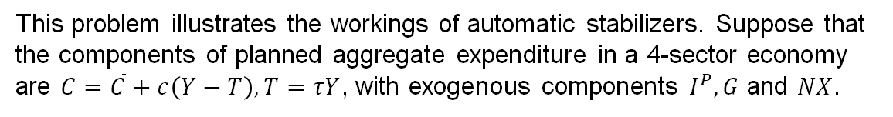
Question 3
This problem illustrates the workings of automatic stabilizers. Suppose that the components of planned aggregate expenditure in a 4-sector economy are $C=\overline{C}+c\left(Y−T\right), T=τY$, with exogenous components $I^{P}, G$ and $NX$.

Slide 67
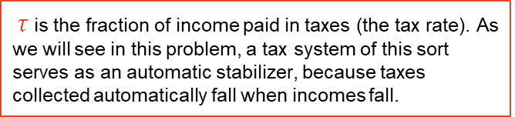
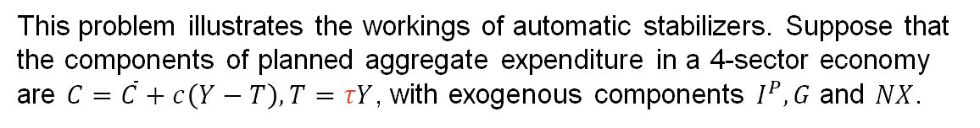
Question 3
This problem illustrates the workings of automatic stabilizers. Suppose that the components of planned aggregate expenditure in a 4-sector economy are $C=\overline{C}+c\left(Y−T\right), T=τY$, with exogenous components $I^{P}, G$ and $NX$.
$τ$ is the fraction of income paid in taxes (the tax rate). As we will see in this problem, a tax system of this sort serves as an automatic stabilizer, because taxes collected automatically fall when incomes fall.

Slide 68
Question 3
This problem illustrates the workings of automatic stabilizers. Suppose that the components of planned aggregate expenditure in a 4-sector economy are $C=\overline{C}+c\left(Y−T\right), T=τY$, with exogenous components $I^{P}, G$ and $NX$.
a. Find an algebraic expression for short-run equilibrium output in this economy

Slide 69
Question 3
This problem illustrates the workings of automatic stabilizers. Suppose that the components of planned aggregate expenditure in a 4-sector economy are $C=\overline{C}+c\left(Y−T\right), T=τY$, with exogenous components $I^{P}, G$ and $NX$.
a. Find an algebraic expression for short-run equilibrium output in this economy

Slide 70

Question 3
This problem illustrates the workings of automatic stabilizers. Suppose that the components of planned aggregate expenditure in a 4-sector economy are $C=\overline{C}+c\left(Y−T\right), T=τY$, with exogenous components $I^{P}, G$ and $NX$.
a. Find an algebraic expression for short-run equilibrium output in this economy
$$Y=C+I^{P}+G+NX$$

Slide 71
Question 3
This problem illustrates the workings of automatic stabilizers. Suppose that the components of planned aggregate expenditure in a 4-sector economy are $C=\overline{C}+c\left(Y−T\right), T=τY$, with exogenous components $I^{P}, G$ and $NX$.
a. Find an algebraic expression for short-run equilibrium output in this economy
$$Y=C+I^{P}+G+NX$$
$$Y=\overline{C}+c\left(Y−τY\right)+I^{P}+G+NX$$

Slide 72
Question 3
This problem illustrates the workings of automatic stabilizers. Suppose that the components of planned aggregate expenditure in a 4-sector economy are $C=\overline{C}+c\left(Y−T\right), T=τY$, with exogenous components $I^{P}, G$ and $NX$.
a. Find an algebraic expression for short-run equilibrium output in this economy
$$Y=C+I^{P}+G+NX$$
$$Y=\overline{C}+c\left(Y−τY\right)+I^{P}+G+NX$$
$$Y=\overline{C}+cY−cτY+I^{P}+G+NX$$

Slide 73
Question 3
This problem illustrates the workings of automatic stabilizers. Suppose that the components of planned aggregate expenditure in a 4-sector economy are $C=\overline{C}+c\left(Y−T\right), T=τY$, with exogenous components $I^{P}, G$ and $NX$.
a. Find an algebraic expression for short-run equilibrium output in this economy
$$Y=C+I^{P}+G+NX$$
$$Y=\overline{C}+c\left(Y−τY\right)+I^{P}+G+NX$$
$$Y=\overline{C}+cY−cτY+I^{P}+G+NX$$
$$Y−cY+cτY=\overline{C}+I^{P}+G+NX$$

Slide 74

Question 3
This problem illustrates the workings of automatic stabilizers. Suppose that the components of planned aggregate expenditure in a 4-sector economy are $C=\overline{C}+c\left(Y−T\right), T=τY$, with exogenous components $I^{P}, G$ and $NX$.
a. Find an algebraic expression for short-run equilibrium output in this economy
$$Y=C+I^{P}+G+NX$$
$$(1−c+cτ)Y=\overline{C}+I^{P}+G+NX$$
$$Y=\overline{C}+c\left(Y−τY\right)+I^{P}+G+NX$$
$$Y=\overline{C}+cY−cτY+I^{P}+G+NX$$
$$Y−cY+cτY=\overline{C}+I^{P}+G+NX$$

Slide 75

Question 3
This problem illustrates the workings of automatic stabilizers. Suppose that the components of planned aggregate expenditure in a 4-sector economy are $C=\overline{C}+c\left(Y−T\right), T=τY$, with exogenous components $I^{P}, G$ and $NX$.
a. Find an algebraic expression for short-run equilibrium output in this economy
$$Y=C+I^{P}+G+NX$$
$$(1−c+cτ)Y=\overline{C}+I^{P}+G+NX$$
$$Y=\overline{C}+c\left(Y−τY\right)+I^{P}+G+NX$$
$$Y=\overline{C}+cY−cτY+I^{P}+G+NX$$
$$Y=\frac{1}{1−c+cτ}⋅(\overline{C}+I^{P}+G+NX)$$
$$Y−cY+cτY=\overline{C}+I^{P}+G+NX$$

Slide 76
Question 3
This problem illustrates the workings of automatic stabilizers. Suppose that the components of planned aggregate expenditure in a 4-sector economy are $C=\overline{C}+c\left(Y−T\right), T=τY$, with exogenous components $I^{P}, G$ and $NX$.
a. Find an algebraic expression for short-run equilibrium output in this economy
$$Y=C+I^{P}+G+NX$$
$$(1−c+cτ)Y=\overline{C}+I^{P}+G+NX$$
$$Y=\overline{C}+c\left(Y−τY\right)+I^{P}+G+NX$$
$$Y=\overline{C}+cY−cτY+I^{P}+G+NX$$
$$Y=\frac{1}{1−c+cτ}⋅(\overline{C}+I^{P}+G+NX)$$
$$Y−cY+cτY=\overline{C}+I^{P}+G+NX$$
Multiplier

Slide 77
Question 3
This problem illustrates the workings of automatic stabilizers. Suppose that the components of planned aggregate expenditure in a 4-sector economy are $C=\overline{C}+c\left(Y−T\right), T=τY$, with exogenous components $I^{P}, G$ and $NX$.
b. Find an algebraic expression for the multiplier. Compare the expression you found to the formula for the multiplier when taxes are fully exogenous as in Problem 2 above

Slide 78
Question 3
This problem illustrates the workings of automatic stabilizers. Suppose that the components of planned aggregate expenditure in a 4-sector economy are $C=\overline{C}+c\left(Y−T\right), T=τY$, with exogenous components $I^{P}, G$ and $NX$.
b. Find an algebraic expression for the multiplier. Compare the expression you found to the formula for the multiplier when taxes are fully exogenous as in Problem 2 above

Slide 79

Question 3
This problem illustrates the workings of automatic stabilizers. Suppose that the components of planned aggregate expenditure in a 4-sector economy are $C=\overline{C}+c\left(Y−T\right), T=τY$, with exogenous components $I^{P}, G$ and $NX$.
b. Find an algebraic expression for the multiplier. Compare the expression you found to the formula for the multiplier when taxes are fully exogenous as in Problem 2 above
$$Y=\frac{1}{1−c+cτ}⋅\overline{C}+I^{P}+G+NX$$

Slide 80

Question 3
This problem illustrates the workings of automatic stabilizers. Suppose that the components of planned aggregate expenditure in a 4-sector economy are $C=\overline{C}+c\left(Y−T\right), T=τY$, with exogenous components $I^{P}, G$ and $NX$.
b. Find an algebraic expression for the multiplier. Compare the expression you found to the formula for the multiplier when taxes are fully exogenous as in Problem 2 above
$$Y=\frac{1}{1−c+cτ}⋅\overline{C}+I^{P}+G+NX$$
Multiplier $=\frac{1}{1−c+cτ}$

Slide 81


Question 3
This problem illustrates the workings of automatic stabilizers. Suppose that the components of planned aggregate expenditure in a 4-sector economy are $C=\overline{C}+c\left(Y−T\right), T=τY$, with exogenous components $I^{P}, G$ and $NX$.
b. Find an algebraic expression for the multiplier. Compare the expression you found to the formula for the multiplier when taxes are fully exogenous as in Problem 2 above
$$Y=\frac{1}{1−c+cτ}⋅\overline{C}+I^{P}+G+NX$$
Multiplier $=\frac{1}{1−c+cτ}$
Old Multiplier $=\frac{1}{1−c}$

Slide 82



Question 3
This problem illustrates the workings of automatic stabilizers. Suppose that the components of planned aggregate expenditure in a 4-sector economy are $C=\overline{C}+c\left(Y−T\right), T=τY$, with exogenous components $I^{P}, G$ and $NX$.
b. Find an algebraic expression for the multiplier. Compare the expression you found to the formula for the multiplier when taxes are fully exogenous as in Problem 2 above
$$Y=\frac{1}{1−c+cτ}⋅\overline{C}+I^{P}+G+NX$$
Multiplier $=\frac{1}{1−c+cτ}$
Old Multiplier $=\frac{1}{1−c}$
Multiplier $<$ Old Multiplier

Slide 83
Question 3
This problem illustrates the workings of automatic stabilizers. Suppose that the components of planned aggregate expenditure in a 4-sector economy are $C=\overline{C}+c\left(Y−T\right), T=τY$, with exogenous components $I^{P}, G$ and $NX$.
c. Show that making taxes proportional to income reduces the multiplier. Explain how reducing the size of the multiplier helps to stabilize the economy, other things constant

Slide 84
Question 3
This problem illustrates the workings of automatic stabilizers. Suppose that the components of planned aggregate expenditure in a 4-sector economy are $C=\overline{C}+c\left(Y−T\right), T=τY$, with exogenous components $I^{P}, G$ and $NX$.
c. Show that making taxes proportional to income reduces the multiplier. Explain how reducing the size of the multiplier helps to stabilize the economy, other things constant

Slide 85
Question 3
This problem illustrates the workings of automatic stabilizers. Suppose that the components of planned aggregate expenditure in a 4-sector economy are $C=\overline{C}+c\left(Y−T\right), T=τY$, with exogenous components $I^{P}, G$ and $NX$.
c. Show that making taxes proportional to income reduces the multiplier. Explain how reducing the size of the multiplier helps to stabilize the economy, other things constant
Multiplier $=\frac{1}{1−c+cτ}$
Old Multiplier $=\frac{1}{1−c}$
Multiplier $<$ Old Multiplier

Slide 86

Question 3
This problem illustrates the workings of automatic stabilizers. Suppose that the components of planned aggregate expenditure in a 4-sector economy are $C=\overline{C}+c\left(Y−T\right), T=τY$, with exogenous components $I^{P}, G$ and $NX$.
c. Show that making taxes proportional to income reduces the multiplier. Explain how reducing the size of the multiplier helps to stabilize the economy, other things constant
Multiplier $=\frac{1}{1−c+cτ}$
$ΔY=$ Multiplier$⋅Δ$(Exogenous variables)
Old Multiplier $=\frac{1}{1−c}$
Multiplier $<$ Old Multiplier

Slide 87

Question 3
This problem illustrates the workings of automatic stabilizers. Suppose that the components of planned aggregate expenditure in a 4-sector economy are $C=\overline{C}+c\left(Y−T\right), T=τY$, with exogenous components $I^{P}, G$ and $NX$.
c. Show that making taxes proportional to income reduces the multiplier. Explain how reducing the size of the multiplier helps to stabilize the economy, other things constant
Multiplier $=\frac{1}{1−c+cτ}$
$ΔY=$ Multiplier$⋅Δ$(Exogenous variables)
Old Multiplier $=\frac{1}{1−c}$
$$I^{P},G,NX$$
Multiplier $<$ Old Multiplier

Slide 88
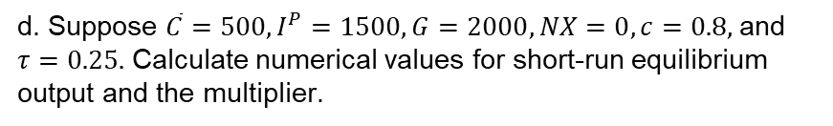

Question 3
This problem illustrates the workings of automatic stabilizers. Suppose that the components of planned aggregate expenditure in a 4-sector economy are $C=\overline{C}+c\left(Y−T\right), T=τY$, with exogenous components $I^{P}, G$ and $NX$.
d. Suppose $\overline{C}=500, I^{P}=1500, G=2000, NX=0, c=0.8,$and $τ=0.25.$ Calculate numerical values for short-run equilibrium output and the multiplier.
$$Y=C+I^{P}+G+NX$$

Slide 89
Question 3
This problem illustrates the workings of automatic stabilizers. Suppose that the components of planned aggregate expenditure in a 4-sector economy are $C=\overline{C}+c\left(Y−T\right), T=τY$, with exogenous components $I^{P}, G$ and $NX$.
d. Suppose $\overline{C}=500, I^{P}=1500, G=2000, NX=0, c=0.8,$and $τ=0.25.$ Calculate numerical values for short-run equilibrium output and the multiplier.
$$Y=C+I^{P}+G+NX$$
$$Y=\overline{C}+c\left(Y−τY\right)+1500+2000$$

Slide 90
Question 3
This problem illustrates the workings of automatic stabilizers. Suppose that the components of planned aggregate expenditure in a 4-sector economy are $C=\overline{C}+c\left(Y−T\right), T=τY$, with exogenous components $I^{P}, G$ and $NX$.
d. Suppose $\overline{C}=500, I^{P}=1500, G=2000, NX=0, c=0.8,$and $τ=0.25.$ Calculate numerical values for short-run equilibrium output and the multiplier.
$$Y=C+I^{P}+G+NX$$
$$Y=\overline{C}+c\left(Y−τY\right)+1500+2000$$
$$Y=500+0.8\left(Y−0.25Y\right)+1500+2000$$

Slide 91
Question 3
This problem illustrates the workings of automatic stabilizers. Suppose that the components of planned aggregate expenditure in a 4-sector economy are $C=\overline{C}+c\left(Y−T\right), T=τY$, with exogenous components $I^{P}, G$ and $NX$.
d. Suppose $\overline{C}=500, I^{P}=1500, G=2000, NX=0, c=0.8,$and $τ=0.25.$ Calculate numerical values for short-run equilibrium output and the multiplier.
$$Y=C+I^{P}+G+NX$$
$$Y=\overline{C}+c\left(Y−τY\right)+1500+2000$$
$$Y=500+0.8\left(Y−0.25Y\right)+1500+2000$$

Slide 92

Question 3
This problem illustrates the workings of automatic stabilizers. Suppose that the components of planned aggregate expenditure in a 4-sector economy are $C=\overline{C}+c\left(Y−T\right), T=τY$, with exogenous components $I^{P}, G$ and $NX$.
d. Suppose $\overline{C}=500, I^{P}=1500, G=2000, NX=0, c=0.8,$and $τ=0.25.$ Calculate numerical values for short-run equilibrium output and the multiplier.
$$Y=C+I^{P}+G+NX$$
$$Y=\overline{C}+c\left(Y−τY\right)+1500+2000$$
$$Y=500+0.8\left(Y−0.25Y\right)+1500+2000$$
$$Y=10000$$

Slide 93
Question 4
Explain the likely implications of the ageing of the population for fiscal policy? In light of these implications, how should fiscal policy respond?

Slide 94
Question 4
Explain the likely implications of the ageing of the population for fiscal policy? In light of these implications, how should fiscal policy respond?

Slide 95
Question 4
Explain the likely implications of the ageing of the population for fiscal policy? In light of these implications, how should fiscal policy respond?

Slide 96
Question 4
Explain the likely implications of the ageing of the population for fiscal policy? In light of these implications, how should fiscal policy respond?

Slide 97
Question 4
Explain the likely implications of the ageing of the population for fiscal policy? In light of these implications, how should fiscal policy respond?

Slide 98
Question 4
Explain the likely implications of the ageing of the population for fiscal policy? In light of these implications, how should fiscal policy respond?
Taxable population decreases
Amount for welfare payment decreases
Reduce pension fund
Raise more tax

Slide 99
Questions?

